Slide 1
Python for Clinical Bioimaging: Ciliary Motion Analysis
UGA ACM faculty Spotlight
March 22, 2018

Slide 2
Cilia and their pathologies

Slide 3
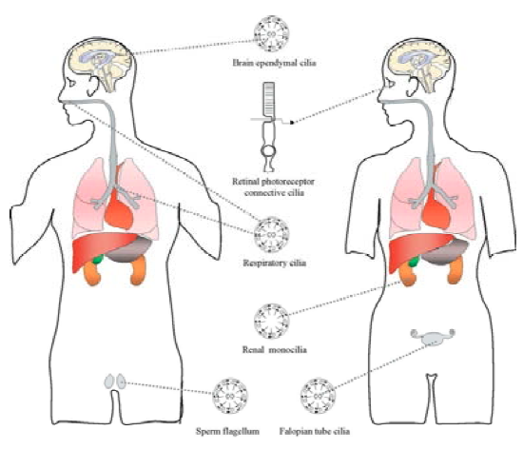
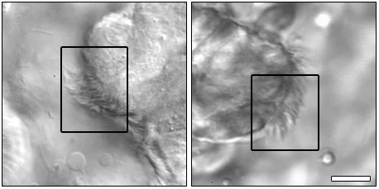
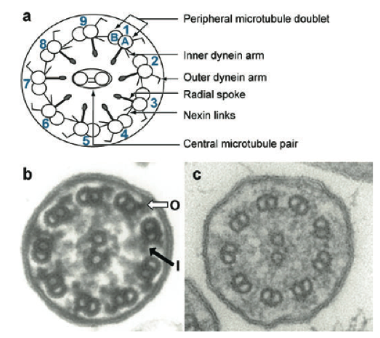
What are cilia?
Scale bars: 10μm
Notes:
Cilia are microscopic hairs that line your throat, nose, lungs, kidneys, brain, and plenty of other places. They protrude from the cell boundary and beat in regular, synchronous waves to move nutrients and trapped irritants where they need to go (this is called the metachronic wave). If you cut one open, it has the structure you see on the right: each cilium looks a little bit like the wheel of a bicycle, complete with spokes, the result of about 200 different proteins forming the structure.
The videos shown here are examples of what healthy ciliary motion looks like. You can clearly see a contiguous wave with a little bit of noise, but the overall motion is largely in synchrony.

Slide 4
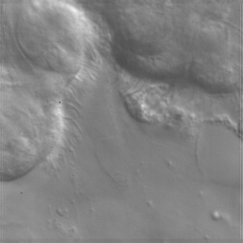
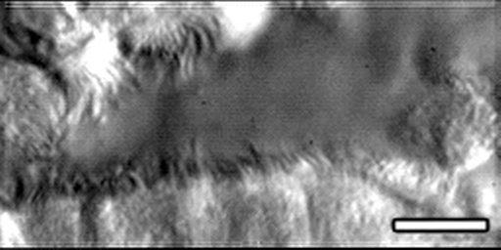
Why do we care about cilia?
Clinical
Ciliopathies
Association with congenital heart disease
Developmental
Nodal flow
Left-right asymmetry
Notes:
Why do we care about cilia? Turns out they play a fairly critical role in keeping us healthy, and disruption in the regular, synchronous motion of cilia can be indicative of a ciliopathy, a disease affecting the cilia directly. Cilia play an important role in the delivery of nutrients and expulsion of irritants, and disturbances in the motion can contribute to a host of conditions that can potentially result in lung scarring and permanent damage. To that end, accurate diagnosis is important.
Cilia play an important role not only in clearing out irritants, but also in embryonic development. It’s been established in the literature that embryonic nodes rely on cilia beating in a circular motion to generate fluid flow, which propagates an asymmetric calcium signaling and, so the theory goes, establishes the internal alignment of organs, or left-right patterning. It’s been shown that disrupting proteins required for ciliary motion which result in abnormal or absent flow does disturb the left-right patterning. This can result in a host of developmental defects, affecting the brain and, in air-breathing mammals, the correct formation of our asymmetric four-chambered heart. This is why congenital heart disease also shows a strong correlation with ciliary motion defects, and why so many patients with CHD also have chronic sinopulmonary conditions.
Simply put, we’d like to learn a little more about this motion and the role it plays.

Slide 5
How do we diagnose ciliopathies?
Cheap, fast, inaccurate
Slow, expensive, accurate (?)
Measure nasal nitric oxide (NO) levels
Ciliary beat frequency (CBF) computation
Electron microscopy to search for structural defects
Manual ciliary beat pattern analysis
“Gold standard”
Notes:
The current diagnostic method relies on a combination of strategies. First is electron microscopy to examine the structure for abnormalities. This is very expensive, and ciliopathies can present without any discernible structural defects. Second is to measure the nasal nitric oxide levels. It's unknown why a higher NO concentration correlates with abnormal ciliary behavior, but while very cheap it also results in a lot of false positives. Third is to measure the rate at which the cilia beat, in cycles per second. Some ciliopathies result in slower or faster beat rates, and while this method is also cheap, CBF has no particular correlation with disease; for instance, CBF drops when the person is under anesthesia. Fourth, clinicians can examine live biopsies under a videomicroscope for motion anomalies. This method is considered the most effective, but it is done manually. A clinician watches the cilia beat and makes a call. Depending on a clinician's training and bias, this is a very subjective call with no relevance to studies done at other clinics.

Slide 6
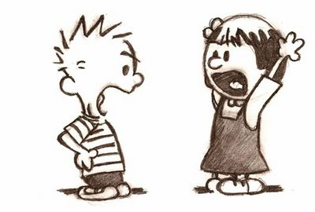

What is our goal?
Input: high-speed video of ciliary biopsy
Output: quantitative properties of observed motion
WAVY!
7.4
Curly!
Notes:
The goal of this project, then, is to develop a method or framework which accepts as input a video (or many, many videos) such as you saw earlier, and returns to the user some quantitative description.
The impetus is we want to eliminate the subjectivity inherent to the current diagnostic ensemble, and replace it with a numerical description that is in some sense objective and therefore useful not only in establishing rigorous definition of ciliary motion and all the types that exist therein, but also in allowing for cross-clinical studies and translational relevance of results that can be compared.

Slide 7
Quantitative features of ciliary motion
Notes:
That’s a 1000-mile view of the biology and public health impetus. The core question for us as computer vision experts, then, is: how do we quantify what we’re seeing? How can we attach numbers to these motion phenotypes in a way that reflects the underlying dynamics?

Slide 8
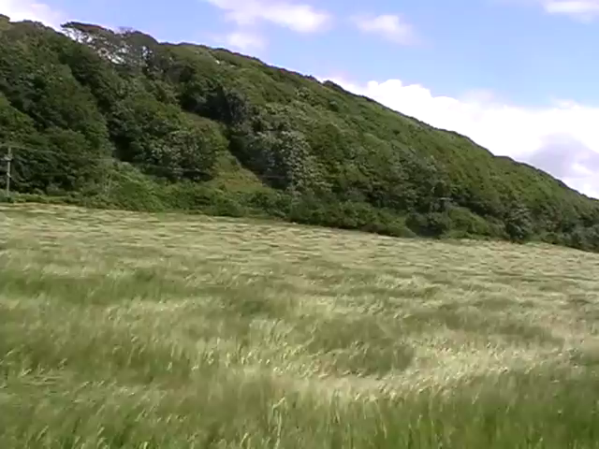
Strategy for quantifying motion
Notes:
As we often do in computer science, we look for problems we already know how to solve, and see if we can cast our current problem into the mold of one of the known problems.
There is a category of problems in computer vision known as “dynamic textures”. These are regular patterns of motion that have some amount of random noise to them. You see examples of these probably every day—clouds billowing, ripples in bodies of water, or as we see here, grass blowing in the wind. It becomes very apparent when we play these two videos side by side that there are definite qualitative similarities between the motions we see. So, the thinking goes, if we apply some of the same analytical methods from the study of dynamic textures to our current problem, perhaps we’ll see some very nice results.

Slide 9
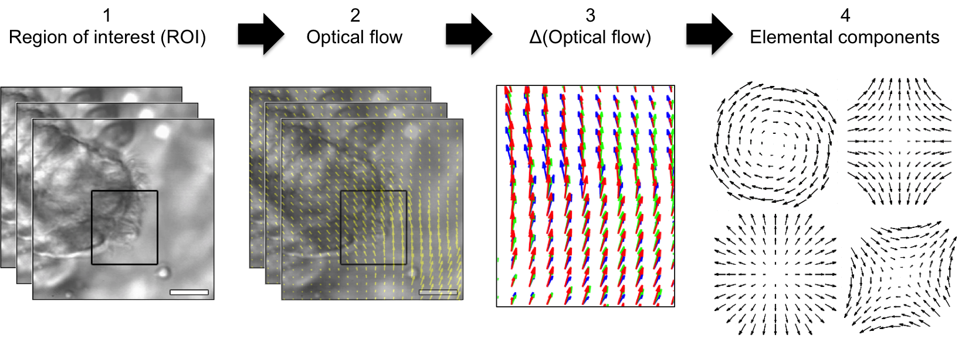
From videos to features
Notes:
The pipeline for analyzing dynamic textures looks something like this. We start with a video or region of interest in the video, and compute the optical flow. Optical flow, for those who aren’t experts in computer vision, is a nice way of estimating the motion that happens between successive pairs of frames. It involves a ton of math and a lot of assumptions about the underlying motion that I won’t go into here, but it mostly gives you a pretty good estimate. What you essentially get back, for each pair of frames, is a vector field—remember those from calculus? Each pixel is represented by a vector that points from where that pixel started in the first frame to where it moved in the second frame, and is computed for every single pixel. That’s step 1 to 2.
In step 3, now we take the derivatives of the optical flow to observe how the motion is changing. Is the motion changing rapidly? Slowly? Not at all? This tells us something important.
Finally, we can use the derivatives of the optical flow to compute what we refer to as “elemental components” of the motion **switch slides**

Slide 10
Aside: Optical Flow
Notes:
Optical flow is a somewhat crude, albeit robust, estimate of movement in a video.

Slide 11
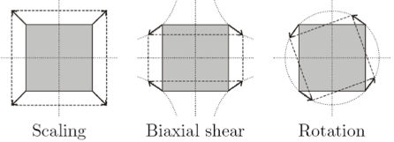
Features describing motion
Scaling (zoom)
Deformation
(biaxial shear)
Rotation (curl)
Not useful in 2D
“Novel use of differential image velocity invariants to categorize ciliary motion defects.” Quinn SP, Francis R, Lo C, Chennubhotla CS. Proceedings of the Biomedical Science and Engineering Conference (BSEC) 2011.
Notes:
These elemental components are fundamental features that describe motion, and are quantities computed at each pixel.
The first is scaling / divergence, or zoom. Second is deformation, or squishing and stretching; third is rotation, or curl. We picked these features because they're first-order and easy to compute directly from the optical flow derivatives, and most importantly have intuitive interpretations. These properties are also invariant to orientation, meaning for example the rotation at one pixel is the same regardless of how the video is oriented.
In our studies, we found scaling wasn't useful (since the videos are 2D, there isn't much zooming), but we found deformation and rotation were extremely useful properties for measuring how the cilia move. To a certain extent, this is intuitively clear: just in observing the motion of cilia beating, rotation of a cilium and how it deforms when it moves can tell us a lot about whether this motion is healthy or indicative of a ciliopathy.

Slide 12
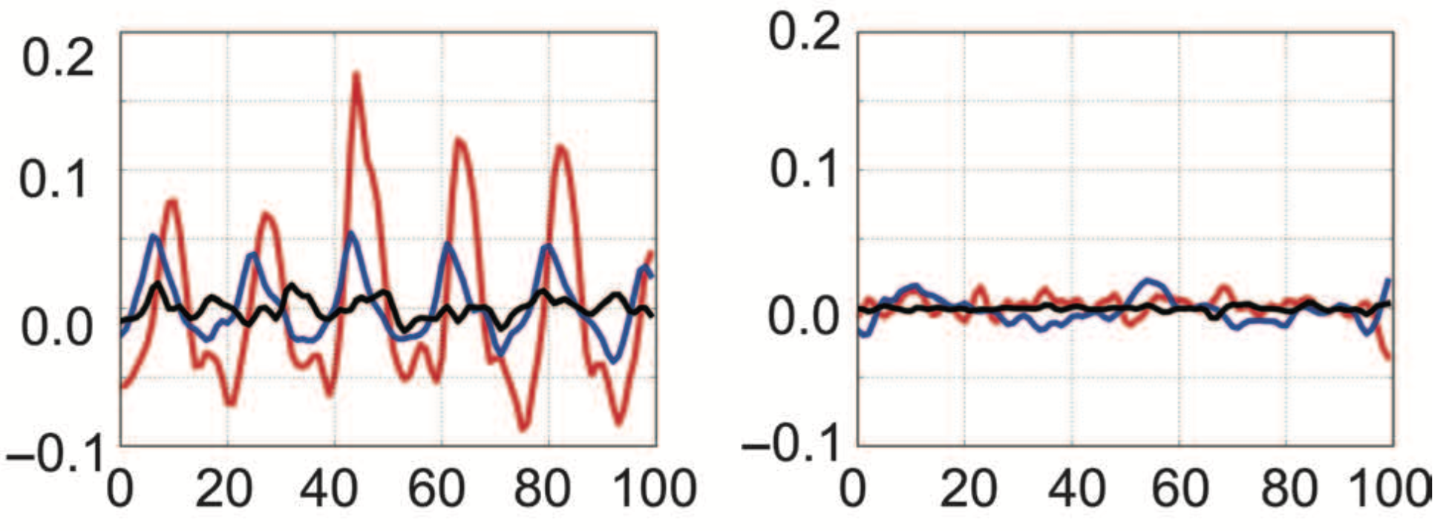
What do these features look like?
Rotation (rad/s)
Notes:
Rotation and deformation, like the gray-level 8-bit pixel intensities, are periodic. The upshot for why we use it is because it's much more robust to effects of noise. I won't go into why here, but you're welcome to ask me after.
The colored dots identify the gray-level pixel intensity changes as this video plays, as well as the rotation computed at those positions as well. For reference I’ve picked a location near the cell wall, at the distal parts of the cilia, and in the background. The point is to show that, even within a single small region, there is a great deal of variability in the tracked signals.
For comparison, I’ve also repeated this process for highly immotile cilia. This is an extreme example, but it paints a very clear picture regarding how these signals can vary depending on the phenotype. Rotation in particular is a full order of magnitude smaller than in the sample on the left, and we see almost no periodicity.
So with these quantitative descriptors of our motion, how can we represent these differences in a way that is robust to the variability we see even in the same region of cilia, but which preserves the differences between regions?

Slide 13
How do we represent these features?
PAUSE
Notes:
Take a step back.

Slide 14
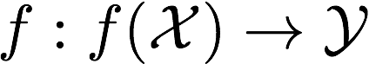
What is the goal of supervised machine learning?
We have our data, X - e.g., videos of cilia
We have our “ground truth”, Y - e.g., whether each video depicted normal or abnormal motion
Define a function f, such that given our data X, it outputs Y as often as possible

Slide 15
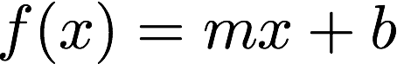
How do we define f?
Easiest possible f: a line
We already have the x and the f(x) (or y)
Need to learn the best m and b to minimize the number of mistakes in computing y**
**Leaving out some details: - the line has to separate the data, not follow it, as would standard linear regression - there are other classifiers that are non-linear (deep neural networks!)

Slide 16
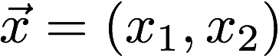
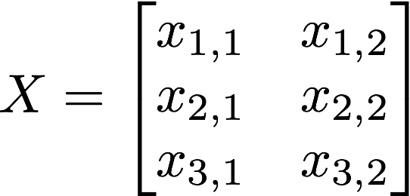
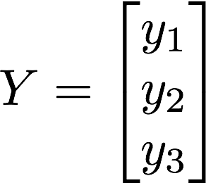
Form of X and Y
A single data point x, then, is often represented as a feature vector - A two-dimensional data point would have two features - Classifier tries to find correlations between features and labels (the ground-truth y value)
Each feature vector is stacked into a matrix X
Each row of the matrix X corresponds to an element of Y
Once you have X and Y, just use any pre-made classifier (scikit-learn, tensorflow, vowpal wabbit)
…but getting the right X is the hard part!

Slide 17
How do we represent these features?
PAUSE
PLAY
Notes:
Take a step back.

Slide 18
How do we represent these features?
Rotation (rad/s)
Notes:
So how do we get this in a nice X-y format?
We already have the y-data from clinicians: we know which videos are “normal” and which are “abnormal”. So we just need a way to get feature vectors out of these time series rotation information.

Slide 19
How do we represent these features?
What is our X?

Slide 20
Simple example
Live Example

Slide 21
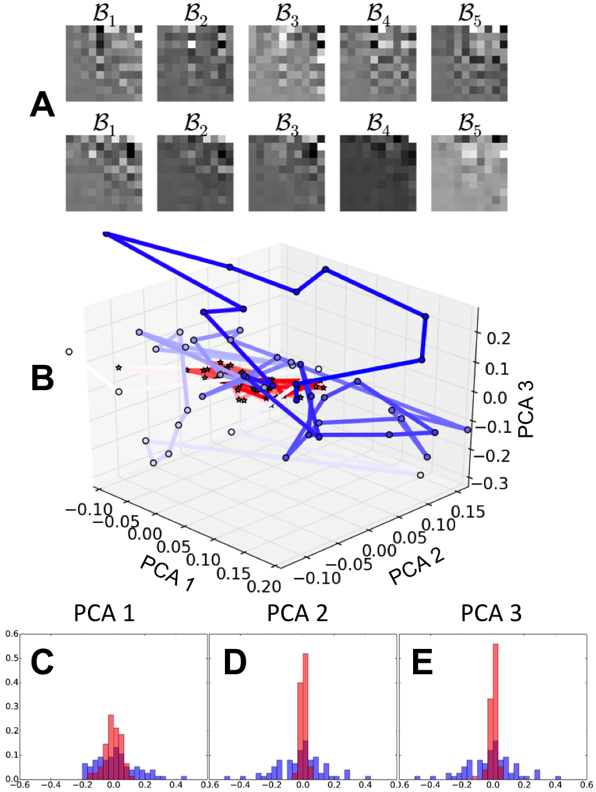
How do we represent these features?
Feature vectors!
Normal
Abnormal
Notes:
Modeling time series usually involves some sort of autoregressive model; if anyone was at the Kalman Filter talk yesterday, you saw it or at least heard it there. The basic idea of this model is to invoke the markov assumption—each observation is a function of some number of previous observations—and build a linear model that explains the majority of what we observe.
(I promise, these two equations are 2/3 of the total number of equations you’ll see!)
With dynamic textures, we take the extra step of first projecting the original time series data (rotation or deformation) into a low-dimensional state space, defined by this projection matrix C. You can define this basis however you’d like; here, we used PCA of 10 dimensions (we found that captured roughly 90% of the variance).
Within the state space, we could use the markov assumption to model the evolution of cilia. Of particular interest are these transition matrices, the parameters of the autoregressive model. They explicitly encode how the cilia move from state to state within the low-dimensional space, and are our quantitative definition of ciliary motion.
Here are some examples. Not much to see, admittedly. It’s tough to tell if there’s a systematic difference in the structure of the parameters between normal and abnormal. But let’s try another visualization: let’s simulate the motion in the state-space of a couple samples, using the learned AR parameters.

Slide 22
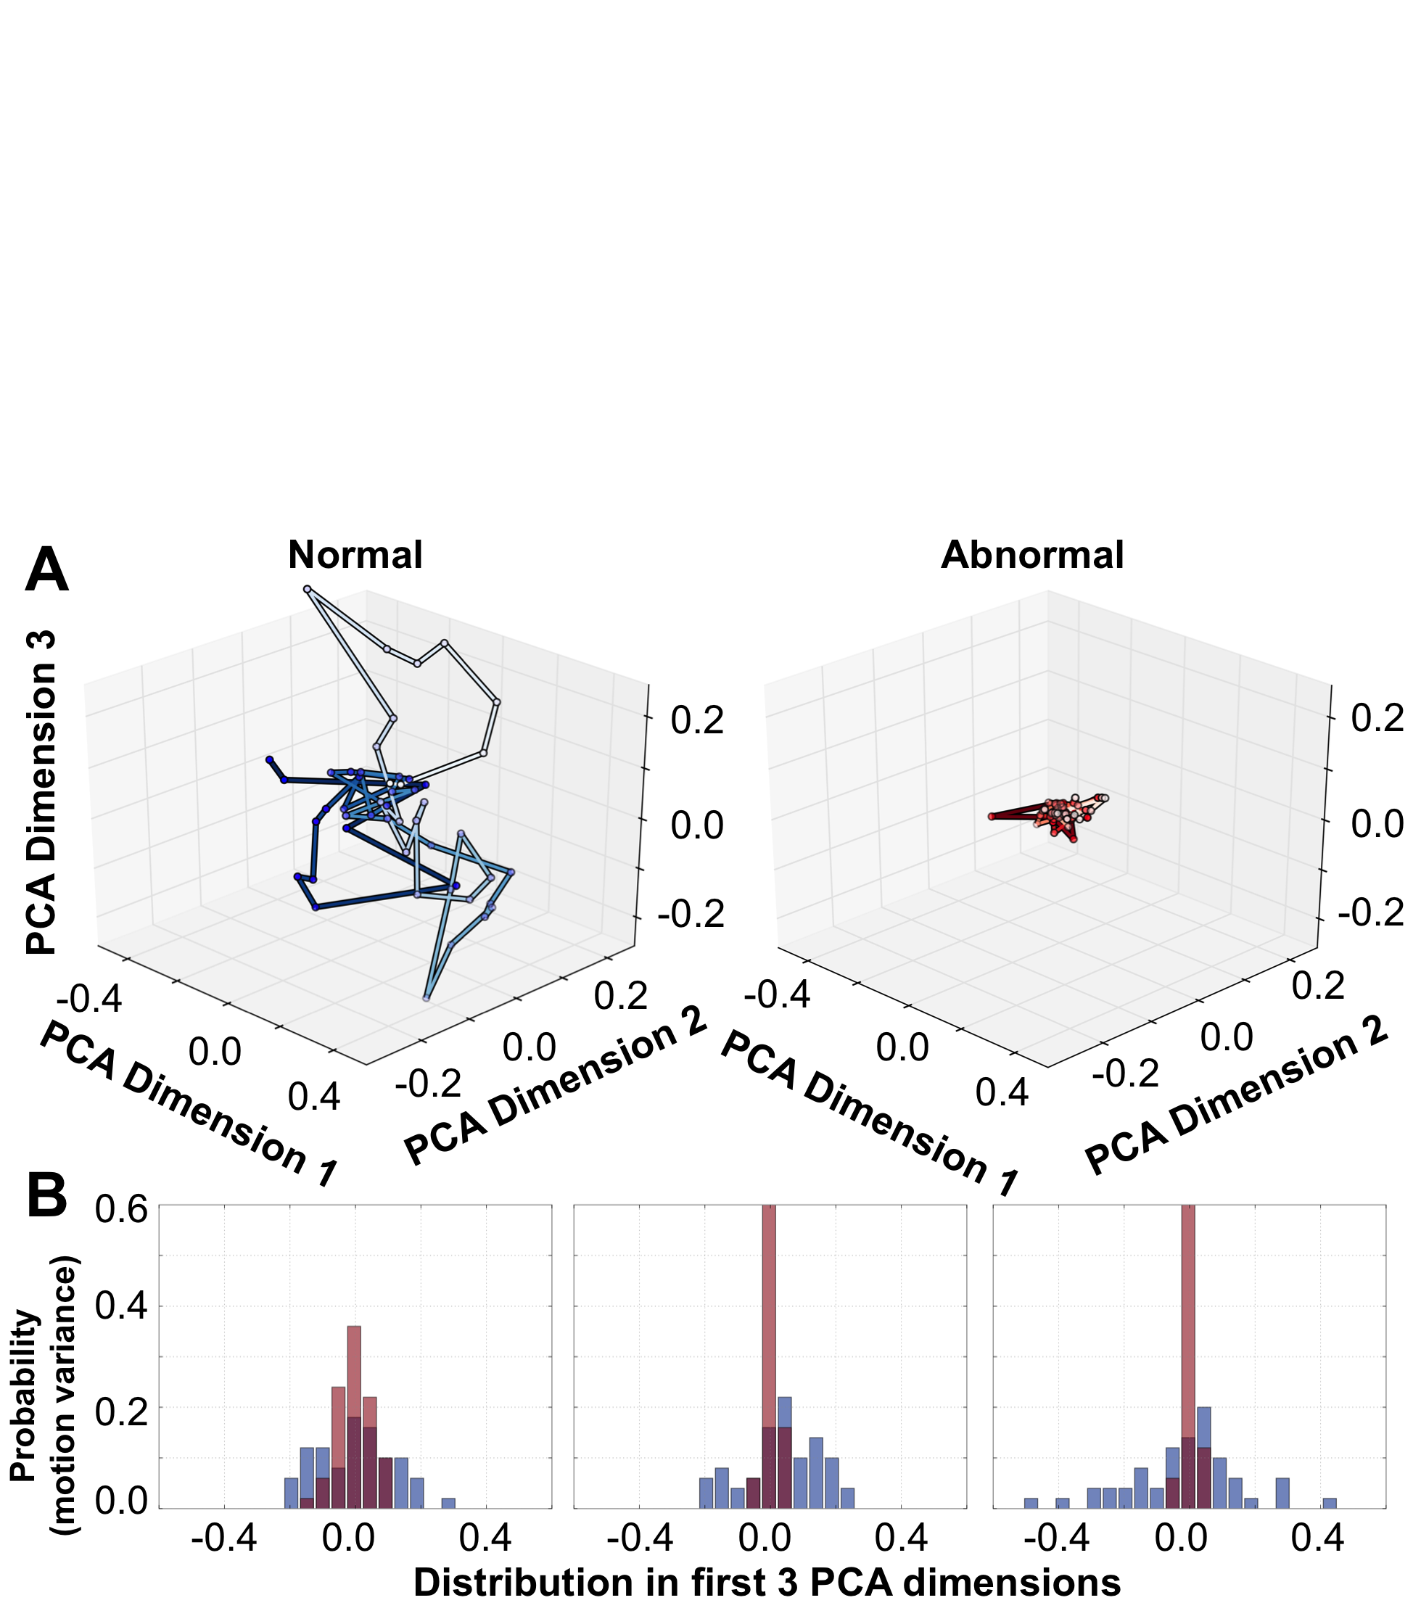
What can we do with these features?
93% classification accuracy
Automated identification of abnormal respiratory ciliary motion in nasal biopsies. Quinn SP, Zahid M, Durkin J, Francis R, Lo C, Chennubhotla CS. Science Translational Medicine 2015.
Notes:
This is what the motion looks like, for two examples: blue is healthy, red is abnormal. We’re using the AR parameters we learned from the low-dimensional time series and iterating it over 50 time points in a 3-dimensional subspace. We can clearly see a difference between the two motion patterns: normal motion has a very large variance and freedom to move in the subspace, while abnormal motion by comparison stays relatively stationary.
This is the pattern we observe across the board: healthy motion has a large freedom of movement in this low dimensional space and requires many dimensions to adequately capture it. Unhealthy motion, by comparison, has very restricted motion and only moves in one or two dimensions in this subspace. Using the AR parameters learned from each video as features vectors, we achieved 93% classification accuracy between normal and abnormal.
Even more interestingly, the 7% we misclassified were consistently misclassified, and on manual re-inspection we noticed that the ground-truth may have been incorrectly established. So we’re pretty happy with this result.

Slide 23
The Python ecosystem
Notes:
That’s the academic research; now, I’ll throw open the door to the sausage factory and show you how it’s done under the hood!

Slide 24
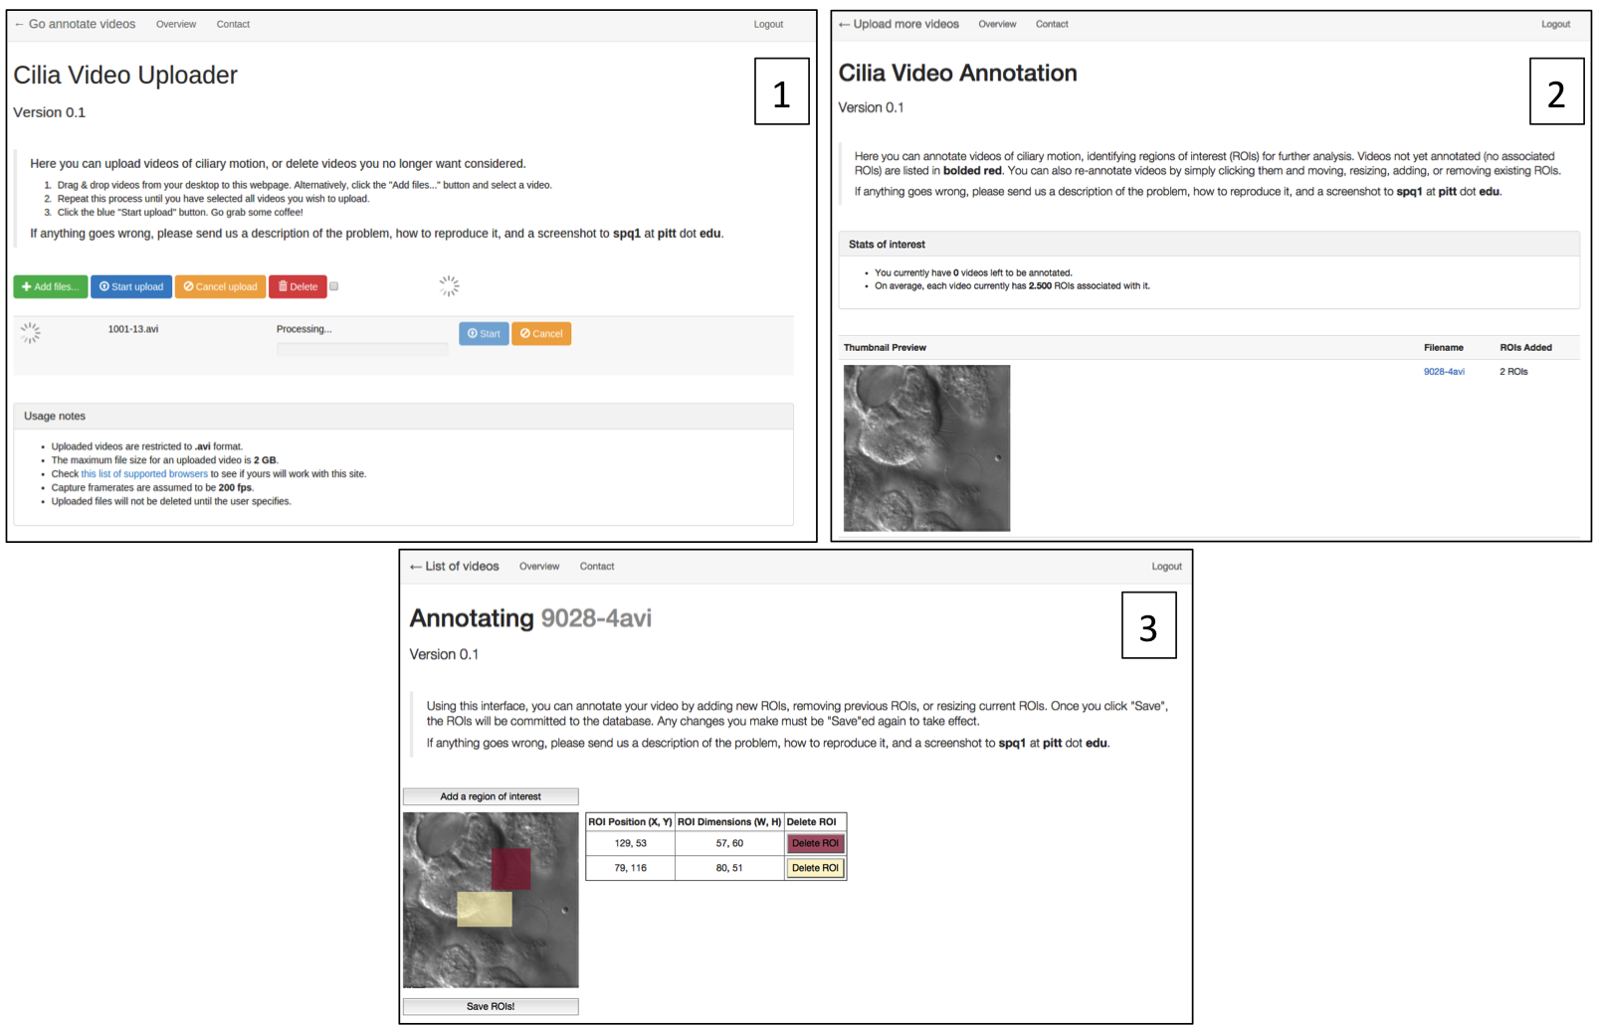

Collecting data from collaborators
Upload to django website
Annotate manually
Save annotations in database using SQLAlchemy
Notes:
The full pipeline had several phases to it. The first, as in any data science project, is collecting the data. In this case, we were collaborating with researchers at the University of Pittsburgh Children’s Hospital who had recruited hundreds of volunteers for their studies. They had obtained live cilia biopsies and recorded dozens of videos of the biopsies for each patient. However, we didn’t particularly care for the idea of passing DVDs or jump drives full of AVIs around, and who knows how we were going to identify regions of interest. So I created a website using django and just enough Javascript to be dangerous, which would allow the researchers to upload the videos directly to our server, and to paint regions of interest on the videos directly in the browser. All these annotations would be saved to a SQLite database, using SQLAlchemy for object-relational modeling.

Slide 25
Processing raw video data
Videos in AVI format
Convert to NumPy arrays with OpenCV
Compute optical flow with OpenCV
Compute rotation with SciPy signal processing filters
Notes:
Once we had the data—large, uncompressed videos in AVI format—we had to extract the ROIs and convert them to data structures Python could use for downstream analysis. We used OpenCV to read the raw AVI files and pull out the ROIs (according to the coordinates stored in the database).
We used the Farneback optical flow algorithm in the OpenCV package to compute the optical flow vectors for all the videos. It worked really well, and was WAY faster than the optical flow algorithm we’d been using in Matlab beforehand.
Finally, to compute the optical flow derivatives and elemental components (rotation, deformation, etc), we used SciPy’s signal processing library. This has a huge selection of spatial filters and their derivatives for differentiating discrete images. With this, we had our rotation and deformation values for every pixel in every ROI in every video.

Slide 26
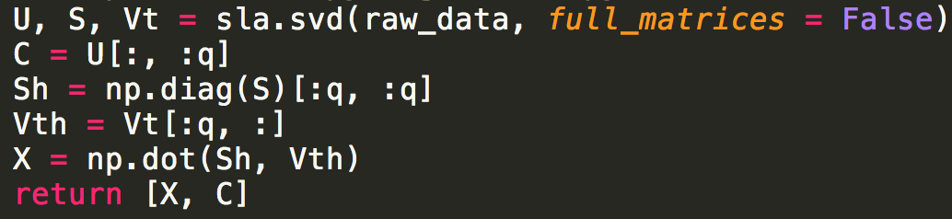
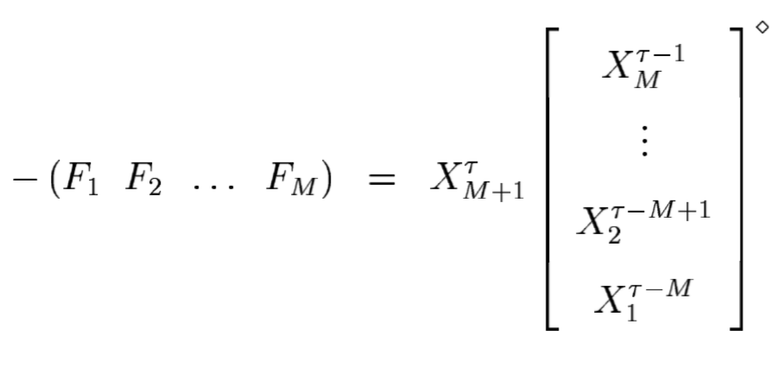
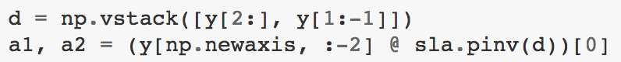
Derivation of time series models
…custom code!
scipy.linalg
Pretty much this!
Notes:
Now, we had to compute the autoregressive time series models.
This was actually done by hand—pyKalMan didn’t exist yet, and I wasn’t yet familiar with enough of the Python ecosystem to reliably search for alternatives. It wasn’t difficult: the pipeline was comprised mostly of an SVD step of the rotation data to derive the low-dimensional subspace, followed by a nasty-looking pseudo-inverse of the low-dimensional time series data to derive the autoregressive parameters F (what I referred to as A in the other slide with equations, because apparently I like confusing everyone). It took about 10 total lines of Python that required close attention to indexing but was otherwise very straightforward, and used some of the core scipy.linalg packages (svd, pinv).

Slide 27
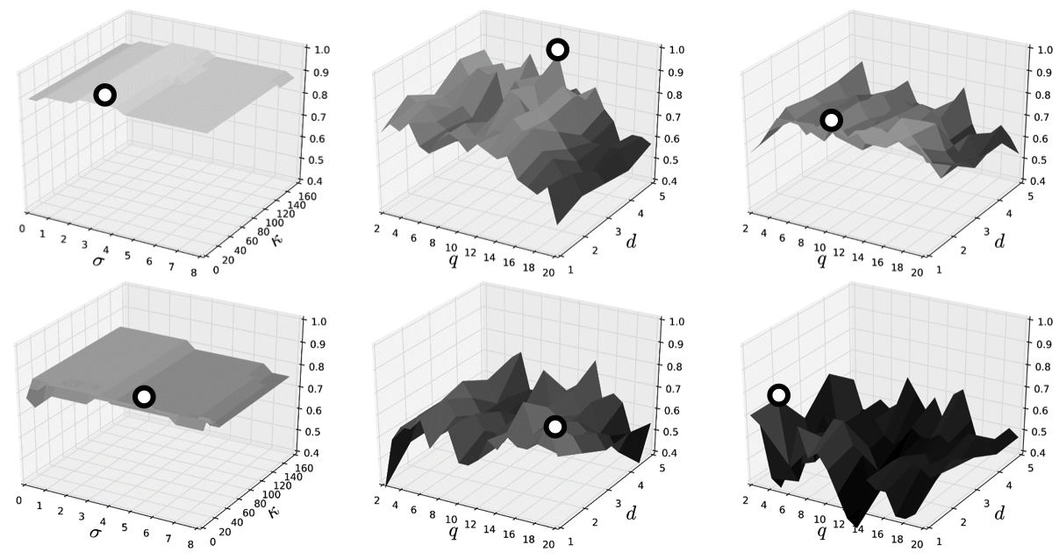
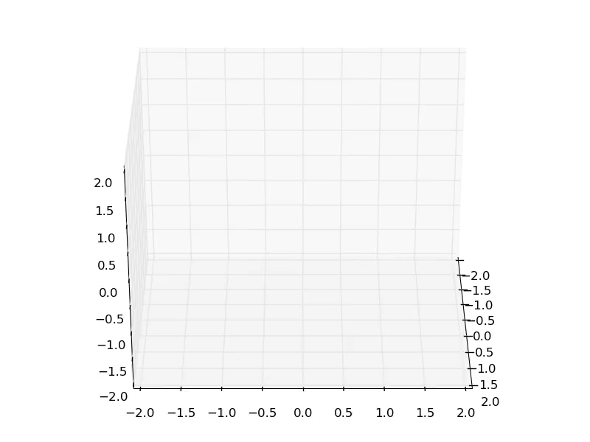
Classification pipeline
Cross-validation for model fitting and testing using scikit-learn
joblib / PySpark for parameter scanning
matplotlib + seaborn / bokeh for visualization
Notes:
Once we had the autoregressive parameters, we were ready to do the classification. This was almost exclusively done in scikit-learn, except when we wanted to test scaling out the analysis to a much larger dataset with hundreds of patients, thousands of videos, and hundreds of thousands of regions of interest (a single video could be up to 2GB). For most of the hyperparameter scans we got away with using joblib to parallelize; for the larger datasets, we’d throw it on a PySpark cluster.
Finally, we used matplotlib and seaborn primarily for visualization and feedback, though we’ve recently started integration bokeh (bouquet) into our aforementioned website to provide initial feedback to users after they upload videos. Straightforward statistics like temporal frequencies that can be computed quickly are rendered in bokeh graphs in-browser.
And that’s the pipeline!

Slide 28
Conclusions and future directions
Notes:
Ok, so there are four parts to my talk. Can’t be a true academic without repeating myself several times, so here are some concluding remarks as well as things we’d like to explore moving forward.

Slide 29
Conclusions
93% classification: methods are sound
Dynamic texture representation is accurate
Blackbox tool for clinicians
Web front-end + Python middleware + Spark back-end
Upload video -> Get analysis
Assist experts with diagnostics
Expert input
Phenotype annotations, regions of interest
Notes:
Our methods are good; we’re recapitulating expert input to a high degree of accuracy.
Ideally, we’d like this to function as a blackbox tool for clinicians.
They upload their videos and the blackbox spits out analysis results. Clinicians would still make the final call, but it would be backed by quantitative evidence.
The system allows experts to provide input in the form of specific regions of interest to help focus our algorithm and ignore parts of videos that don’t necessarily have physiological meaning.

Slide 30
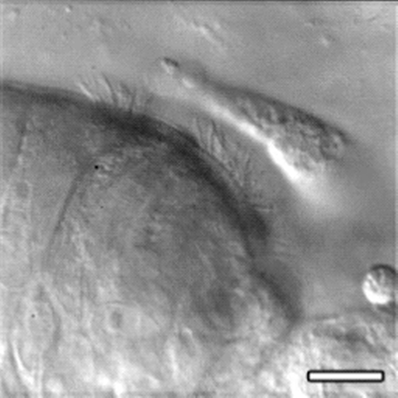
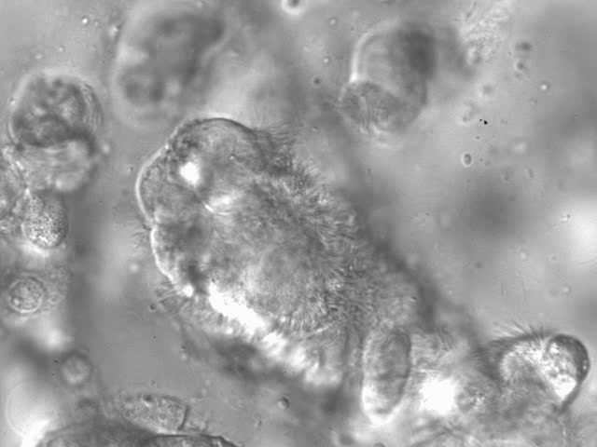
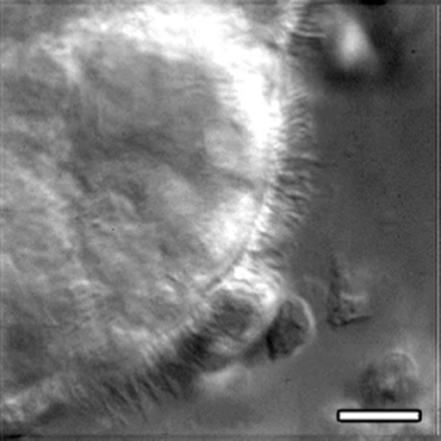
Future directions: Motion Subtypes
Normal / Abnormal is an oversimplification…
Unsupervised motion clustering pipeline
Associate specific motion phenotypes with clinical conditions
Notes:
Moving ahead, the biggest thing we’d like to work on is throwing out everything we’ve done. Ok not quite, but any clinician in this area will tell you the story is much more complicated, much richer than a simple binary normal / abnormal. Unfortunately, no clinician can agree on what all the distinct motion subtypes are; indeed, here are four.
So we’ll need to move from a supervised framework to an unsupervised one that can discover these latent motion patterns. This is not only a very interesting machine learning problem, but it has clinical relevance: recent studies are showing potential links between ciliopathies and specific underlying physiological consequences. Put another way, specific ciliary motion subtypes may correlate with specific physiological maladies, providing yet another avenue for clinical diagnostics.

Slide 31
Future directions: Motion Manifold
Related to the notion of motion subtypes
Manifold: fancy name for “universe of all possibilities”
Representation Learning - What does the manifold look like? - What biological insights does the manifold shape give us? - How many ways are there to traverse the manifold? - What manifold pathways are similar or different to other pathways?

Slide 32
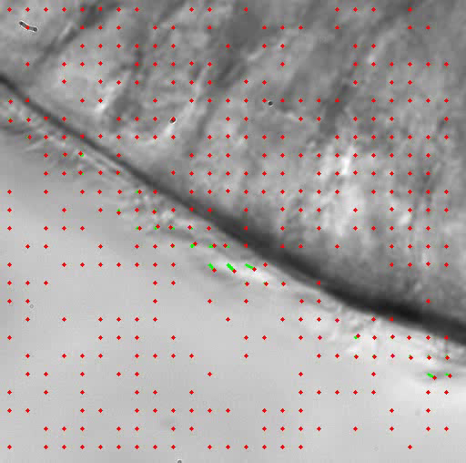
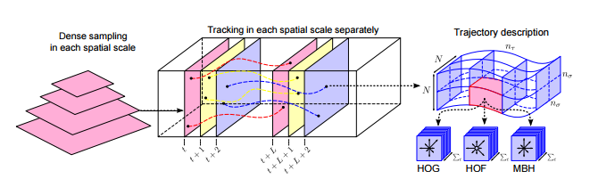
Future directions: Dense Trajectories
Optical flow has its limits
AR models rely on identical framerates
Imagine: dropping a bead into the cilia and watching where it goes
Notes:
One thing we’ve learned in our supervised framework is that the features we’re computing aren’t very sensitive to motion subtypes. Sure, they can distinguish normal from abnormal, but shades of these super-groups have been much more difficult to separate.
We’ve wanted to try and track individual cilia for awhile, but given the occlusion and relatively low-resolution of videos, this is nigh impossible. However, what we can do is to “simulate” the motion of a dropped object—at a given location, where does it move? Then, we can compute properties of the motion of the object, tracking it as we would any other discrete object.
This handles another problem. With AR models, the parameters are built assuming frames to be the unit of time. What happens when you’re trying to compare two videos with different framerates? Interpolation is easy enough if one video is 400fps and the other is 200fps, but what happens when you get a video at 384fps (not kidding, this is real)? Dense trajectories let us interpolate the motion of the tracked object into any framerate we want.

Slide 33
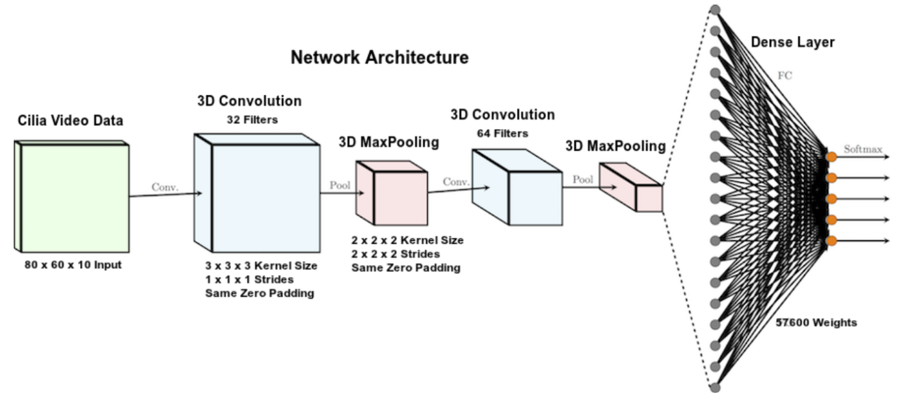
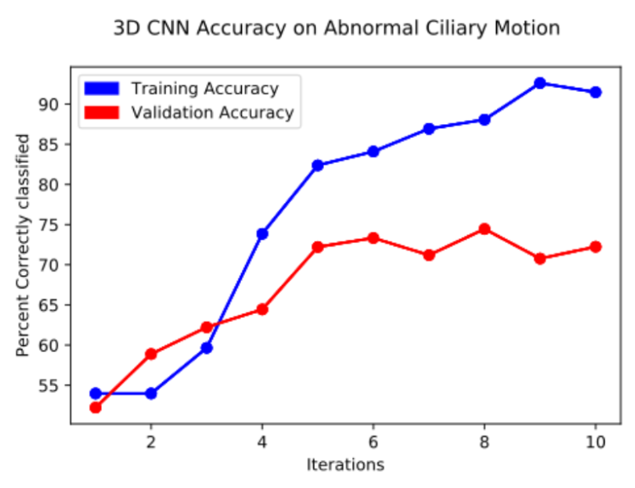
Future directions: Deep Learning
Deep CNNs may be sensitive enough
Accepted to ACMSE 2017
Notes:
And the inevitable “deep learning” slide. See how I’ve spent almost 30 minutes discussing these intricate flow features and derivatives and dynamic textures—you may be wondering why even bother with any of that, and just let a CNN learn the features for us?
We’ve started, in fact: thanks to my student Charles--whose work will show up at ACMSE next week—we’ve tried to replicate the binary classification results using CNNs. We haven’t yet achieved the 93% validation accuracy from before, but this comes with several caveats: we’re not using manually-chosen ROIs here, nor are we computing super-complicated nonlinear SVM kernels: these results took the rotation data for entire videos, generated the CNN feature maps, and attempted binary classification. Not bad for a first pass!

Slide 34
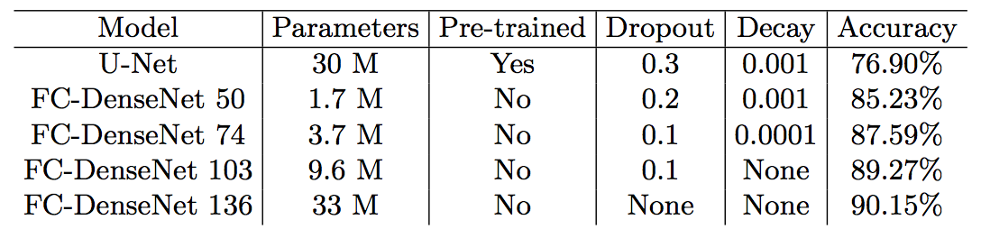
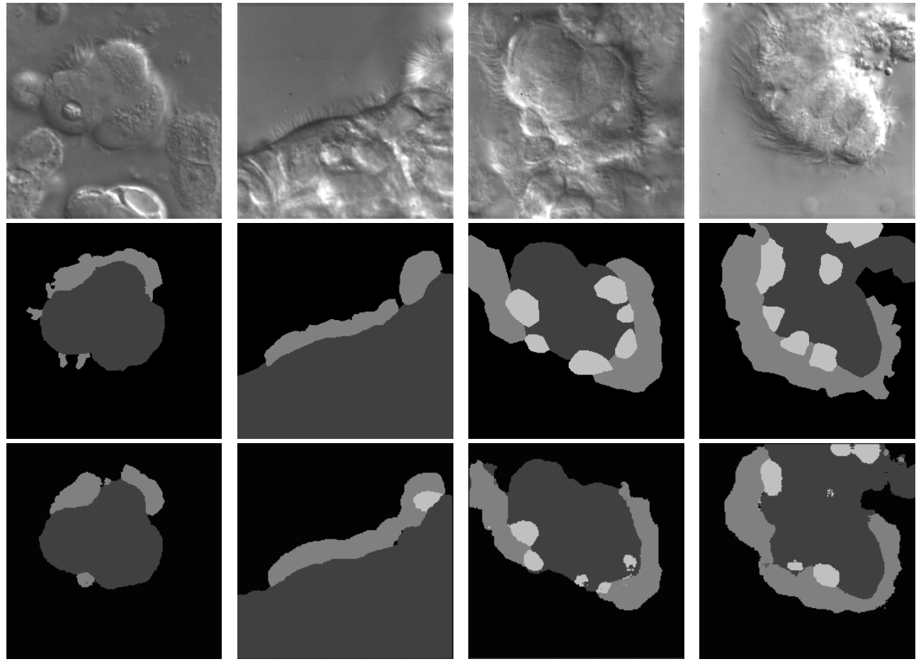
Future directions: Automated segmentation
Major weakness of 2015 Science paper: required manual ROI identification
Labor-intensive! Potentially wrong!
Trained deep networks offer pretty solid segmentation results of cilia from cell and background
Still not fully unsupervised segmentation, but a great step (accepted to ISBI 2018 in D.C. this coming April!)
Notes:
Only the first frame of each video is used so that the model avoids relying on any information about ciliary motion in the temporal dimension for segmentation.
Black represents the background class; dark gray represents the cell body; medium gray represents the side cilia; light gray represents the top cilia.
The best model attains, on average, 90.15% overall pixel accuracy on the holdout test set. This is a about 13% more accurate than the U-Net baseline. Even the FC-DenseNet with 50 layers is 8% more accurate than the baseline. This differ- ence in performance is considerable especially since FC-DenseNet 50 has 10× fewer parameters than the baseline. In addition, despite achieving better perfor- mance, none of the DenseNet models were pre-trained on ImageNet. DenseNets also needed less regularization and converged to a minima faster than the base- line model.
Sometimes the FC-DenseNet correctly predicted background cilia even when they were not annotated in the ground truth (Figure 2. 2nd column). Addition- ally, there is some ambiguity in the distinction between side and top cilia in the manual annotations.

Slide 35
Interested?
I’m always looking for motivated students, including undergrads!
Computer Vision / Biomedical Imaging
Scalable Machine Learning
Unsupervised Deep Learning
Open and Reproducible Science
Let’s talk!

Slide 36
Students and Collaborators
University of Pittsburgh
Dr. Chakra Chennubhotla
University of Pittsburgh Medical Center
Dr. Cecilia Lo
Dr. Maliha Zahid
Dr. Richard Francis
University of Pittsburgh REU
Maurice Marx
University of Georgia
Charles Lu
Prajay Shetty
Alekhya Chennupati

Slide 37
Thank you!
spq@uga.edu
@SpectralFilter
https://magsol.github.io/

